Slide 1
Visualizing Public Health Data

Slide 2
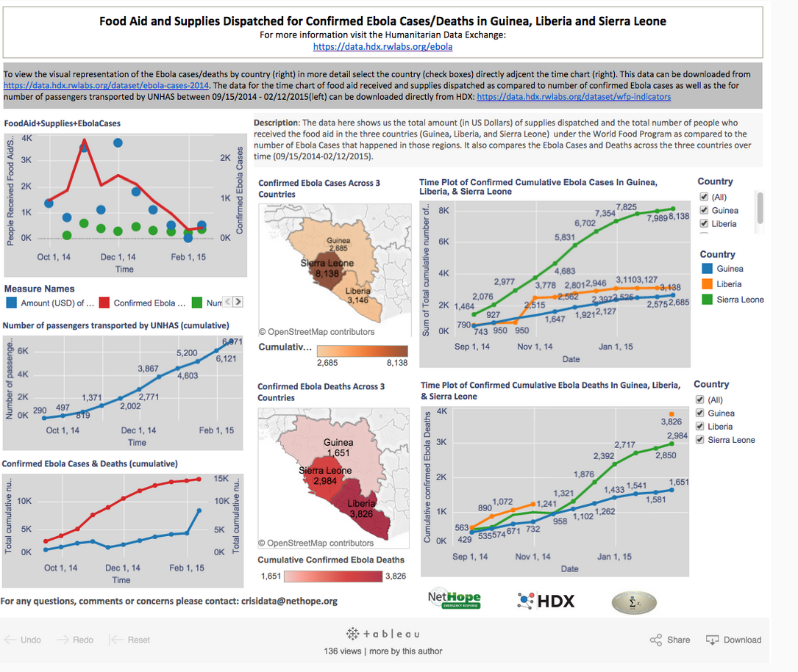
Ebola Response 2014-2015
https://www.tableau.com/solutions/customer/collaborating-crisis-nethope

Slide 3
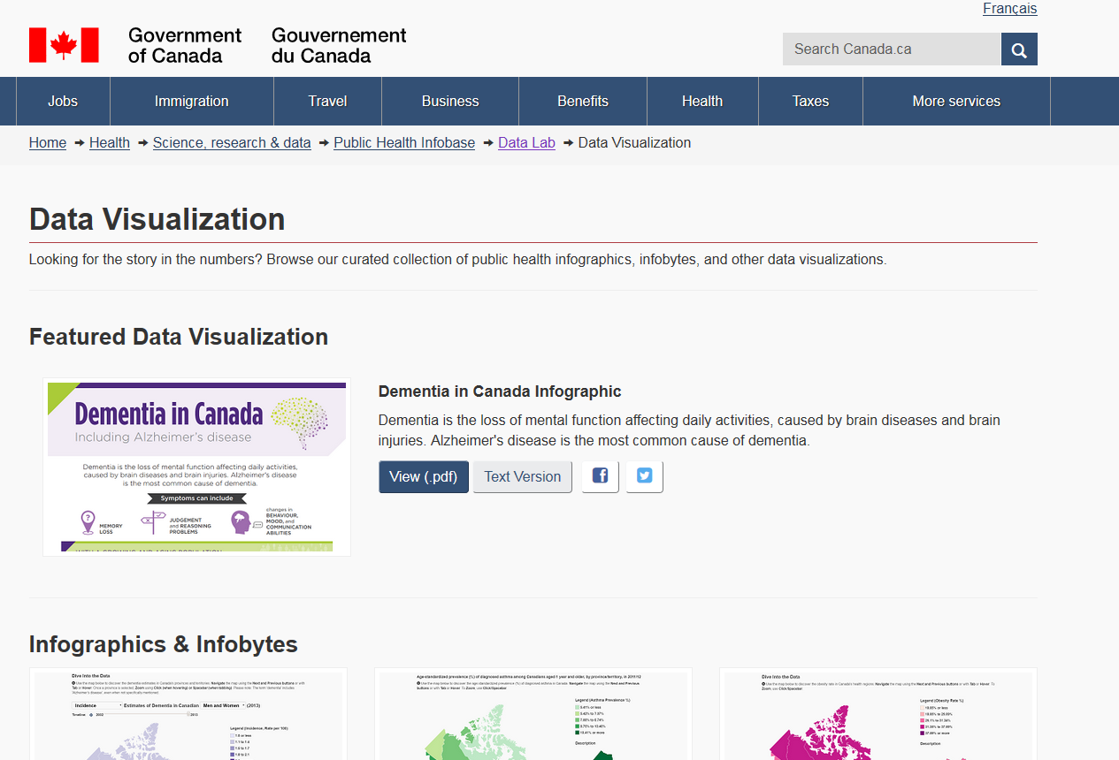
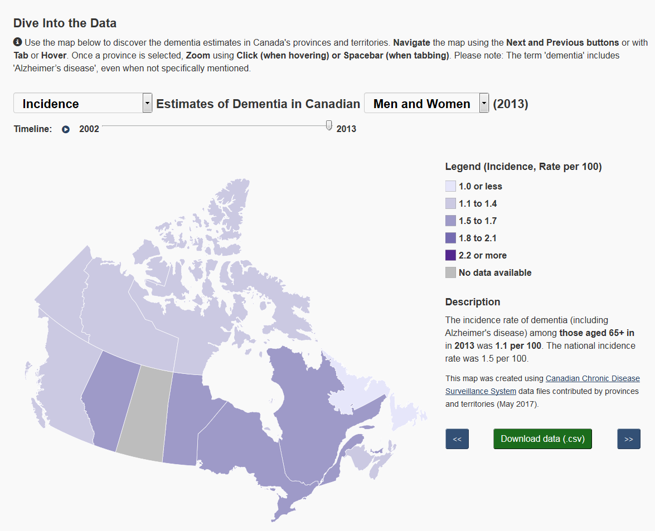
Gov of Canada Public Health Data Lab
https://infobase.phac-aspc.gc.ca/datalab/visualize-en.html

Slide 4
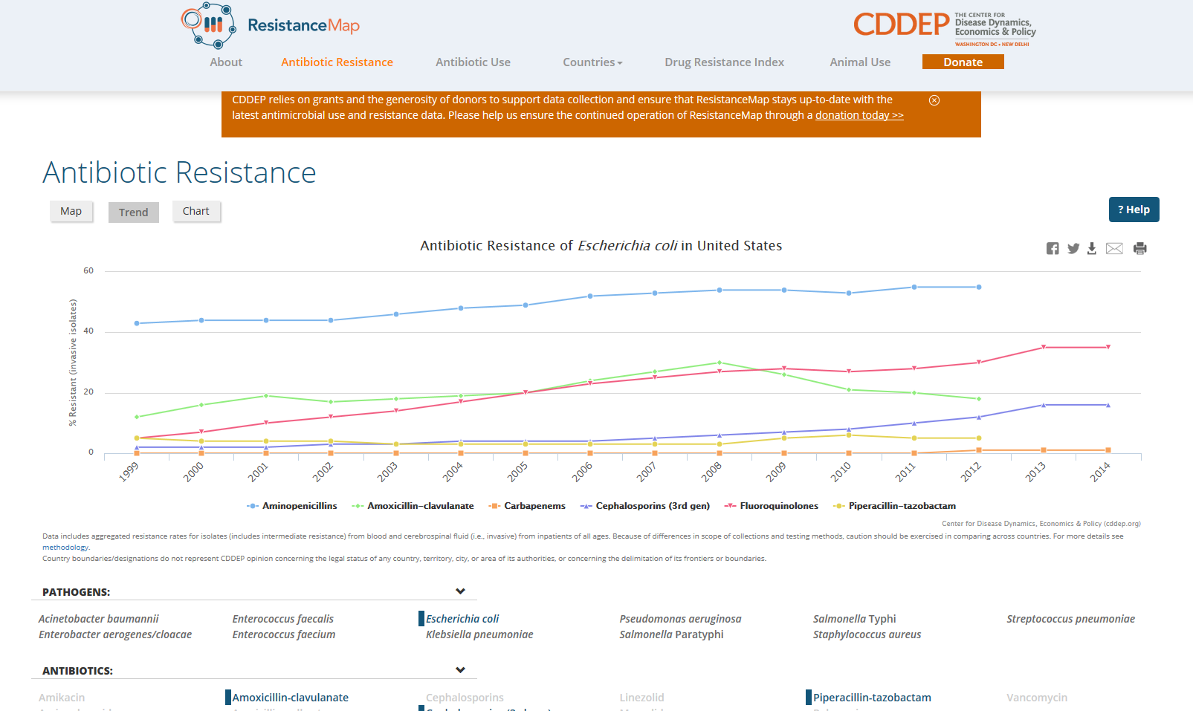
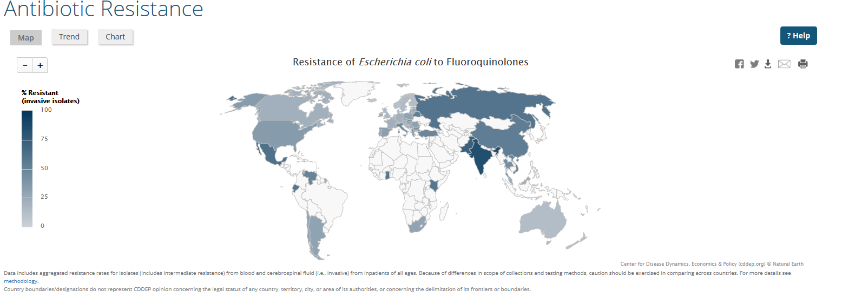
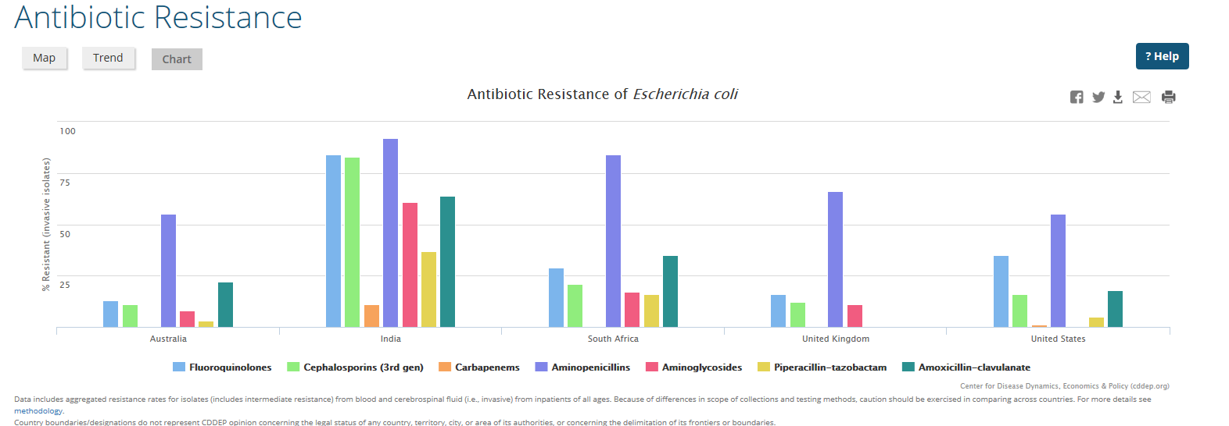
Antibiotic resistance
https://resistancemap.cddep.org/AntibioticResistance.php

Slide 5
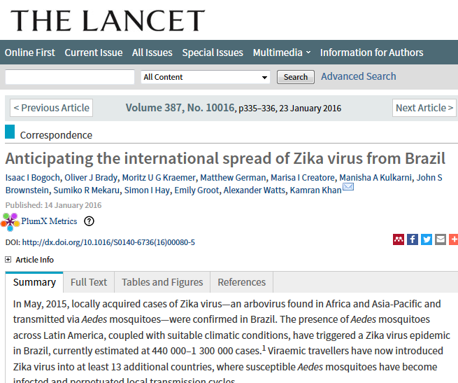
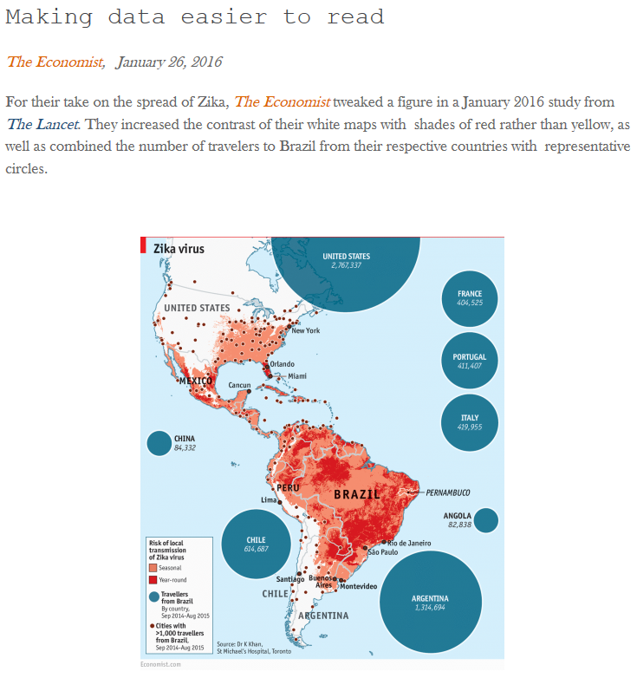
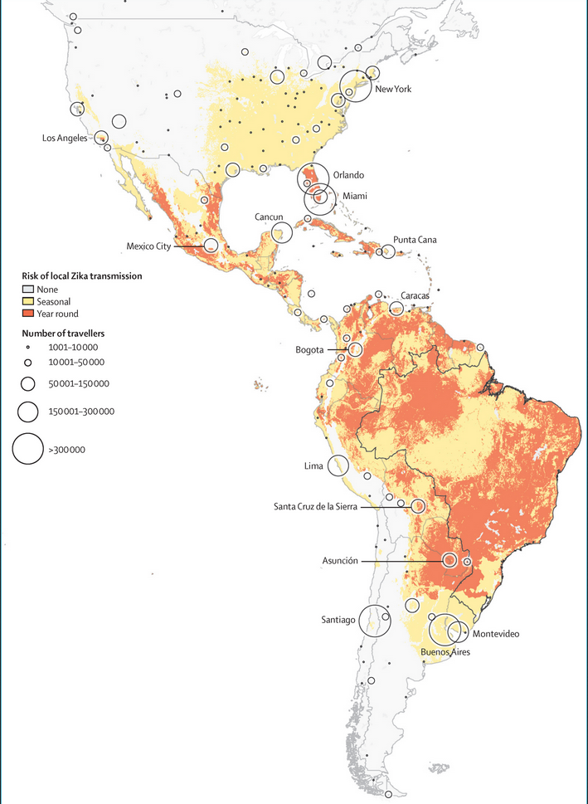
Zika Virus
http://www.thelancet.com/journals/lancet/article/PIIS0140-6736(16)00080-5/fulltext
http://www.storybench.org/spread-zika-virus-roundup-visualizations/

Slide 6
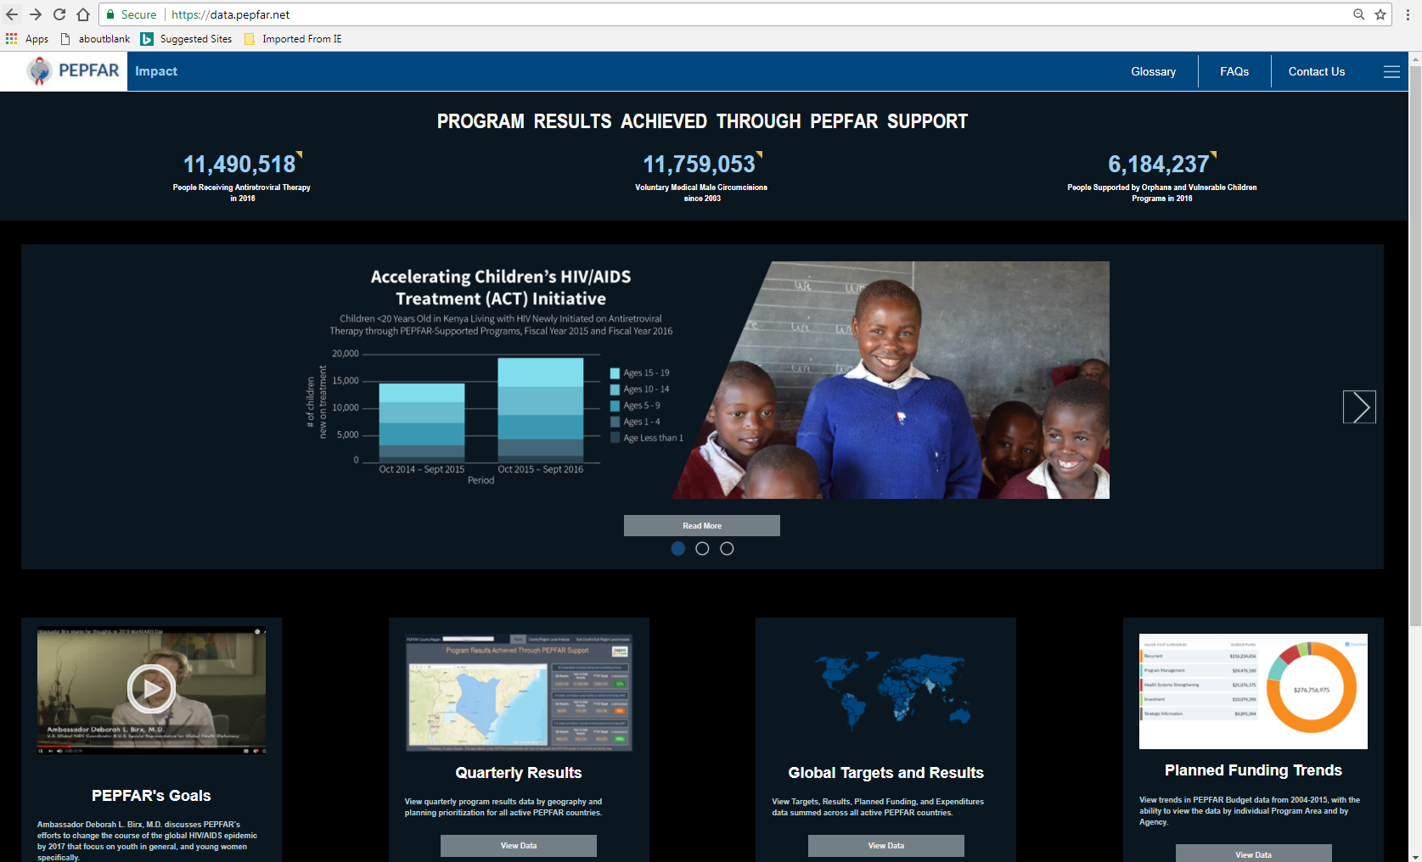

Slide 7
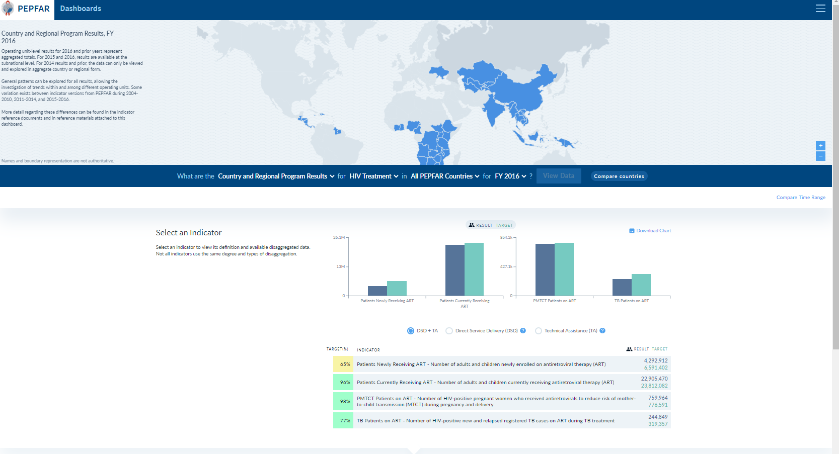
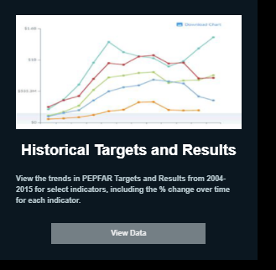
https://data.pepfar.net/

Slide 8
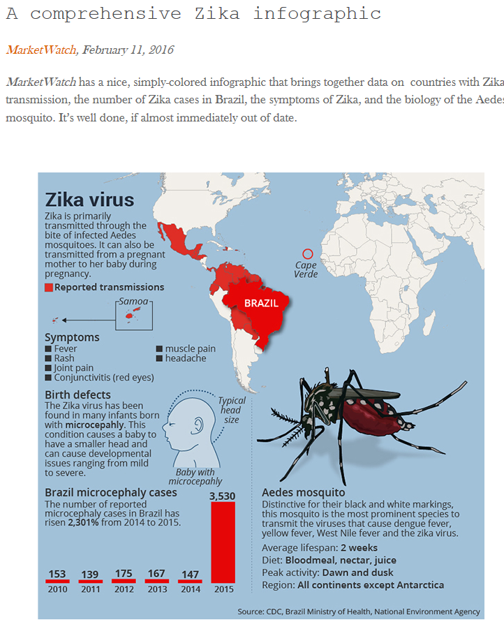
Zika virus
http://www.storybench.org/spread-zika-virus-roundup-visualizations/

Slide 9
How should I visualize X type of data?
Some resources as a guide…

Slide 10
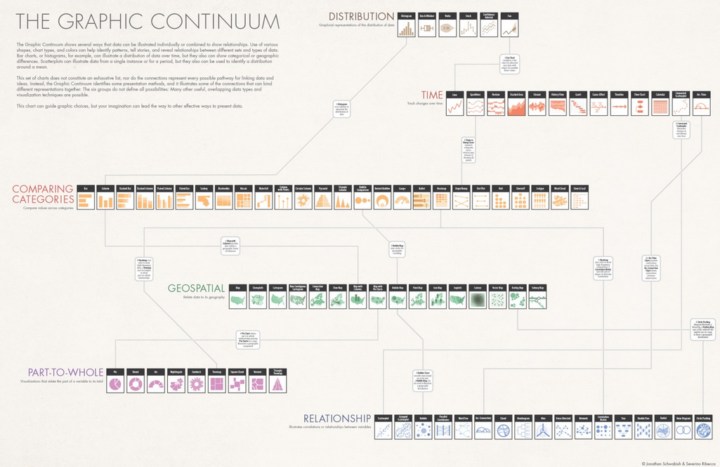
https://visual.ly/blog/graphic-continuum/

Slide 11
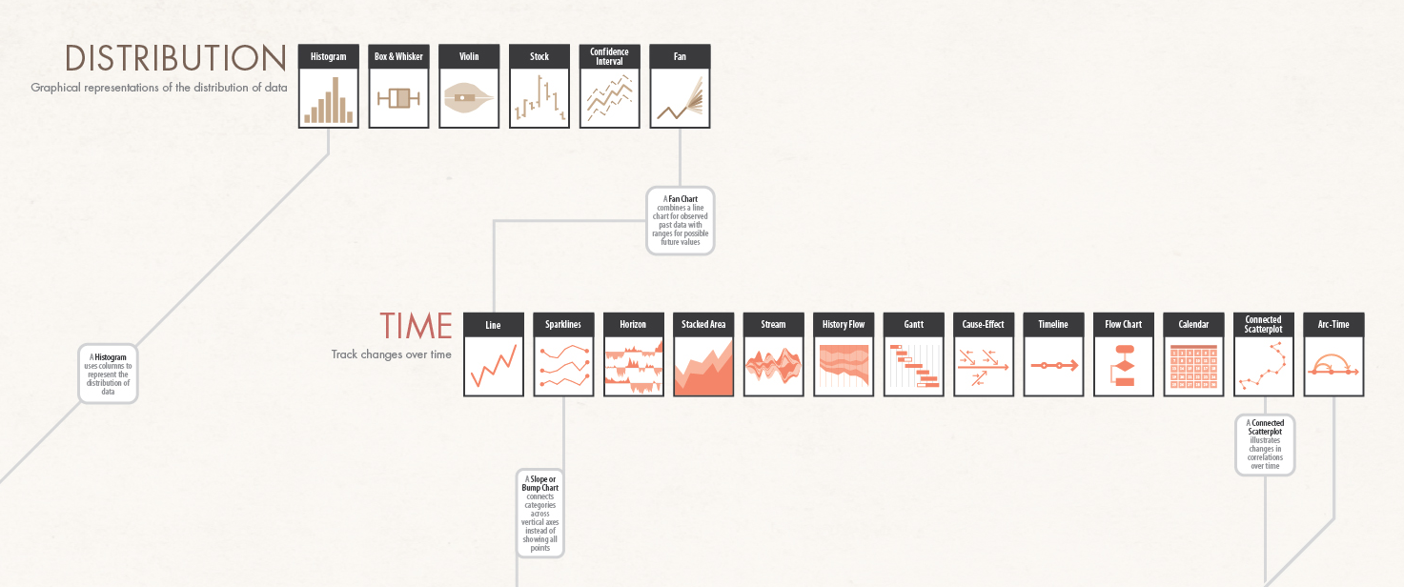
https://visual.ly/community/infographic/how/graphic-continuum

Slide 12
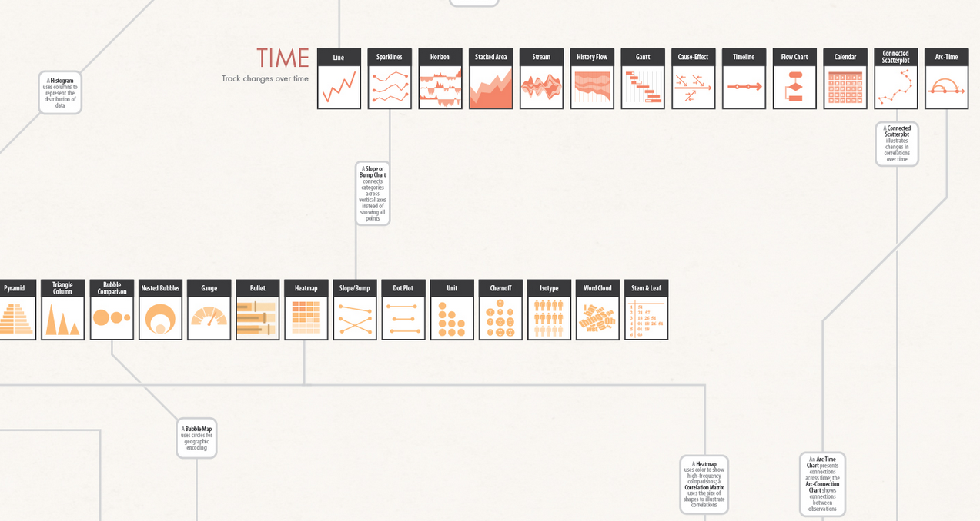
https://visual.ly/community/infographic/how/graphic-continuum

Slide 13
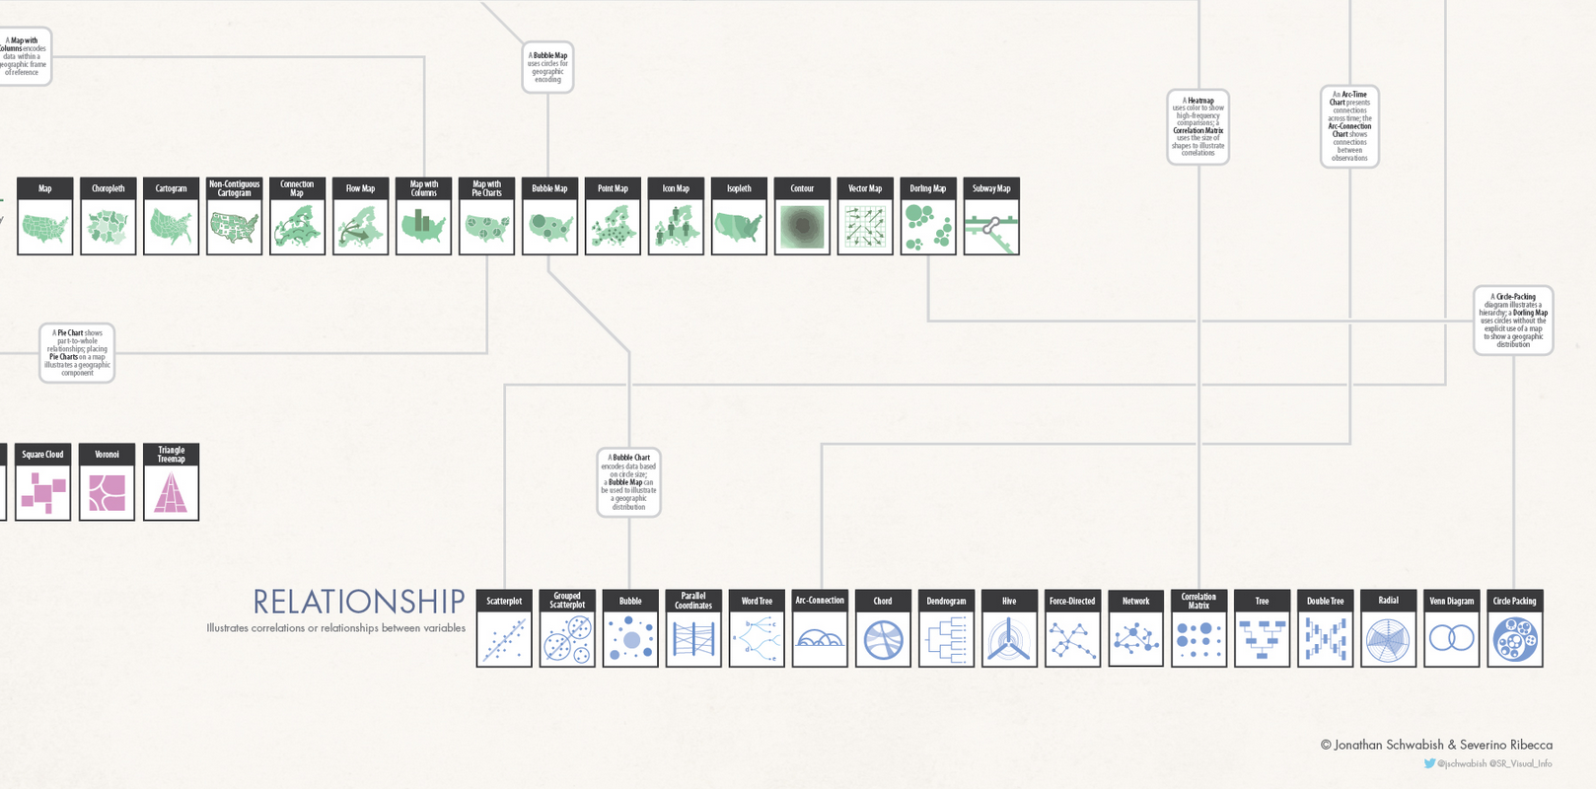
https://visual.ly/community/infographic/how/graphic-continuum

Slide 14
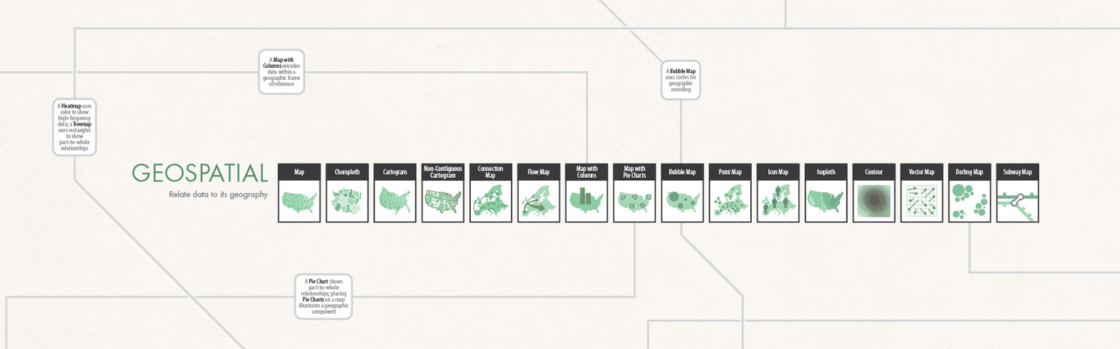
https://visual.ly/community/infographic/how/graphic-continuum

Slide 15
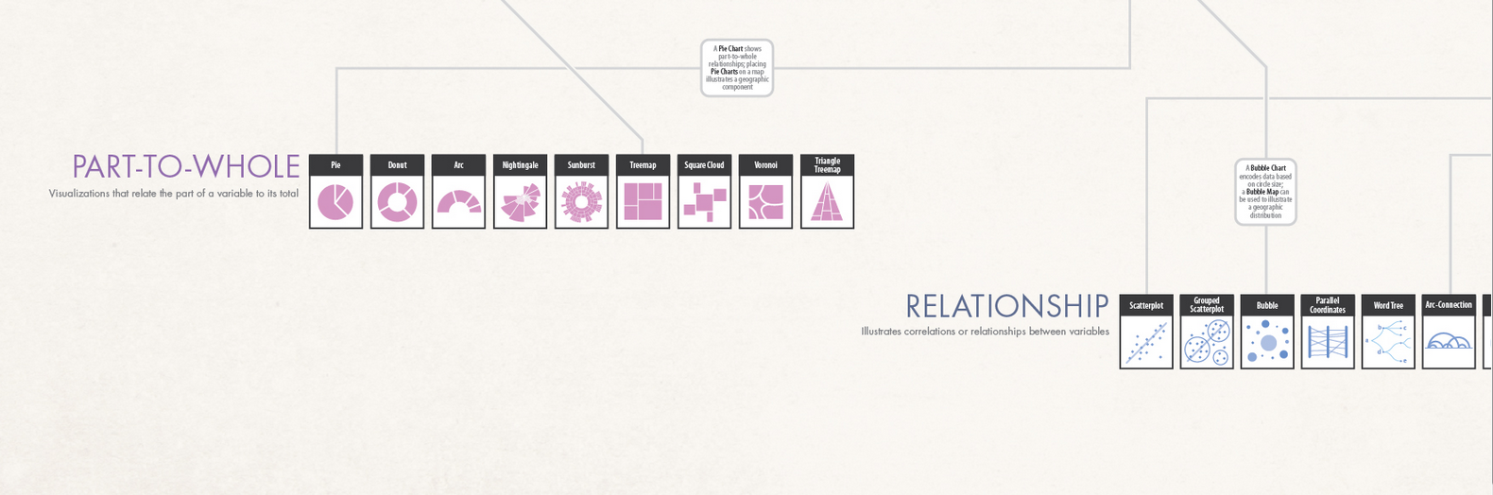
https://visual.ly/community/infographic/how/graphic-continuum

Slide 16
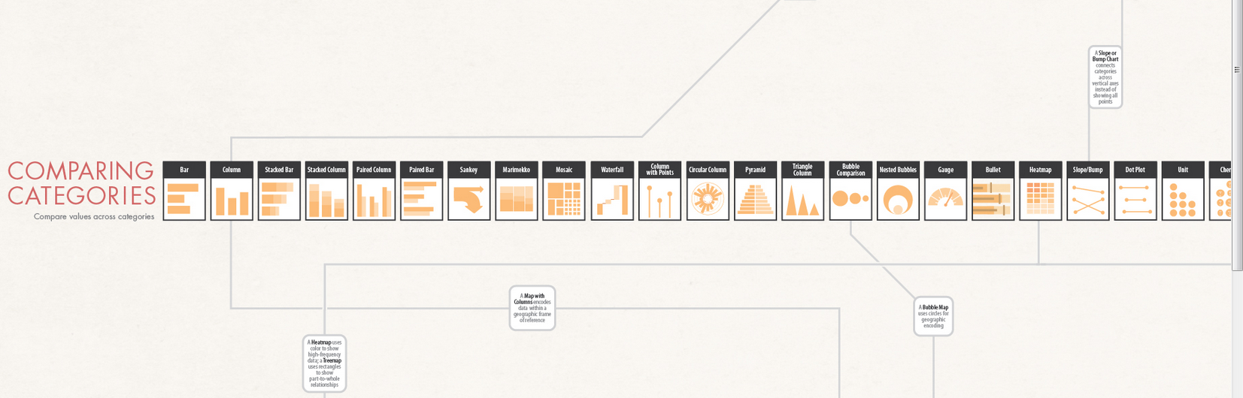
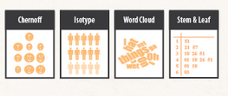
https://visual.ly/community/infographic/how/graphic-continuum

Slide 17
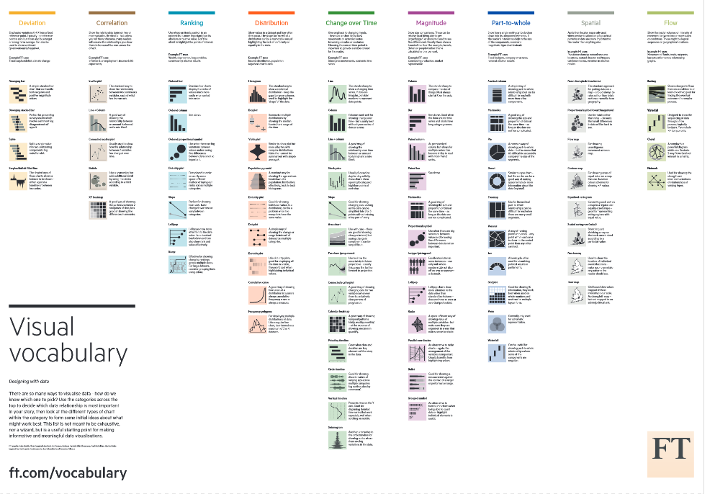
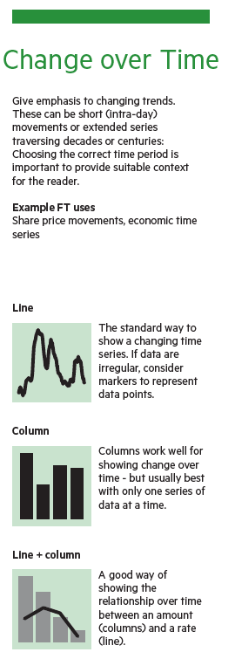
https://github.com/ft-interactive/chart-doctor/blob/master/visual-vocabulary/Visual-vocabulary.pdf

Slide 18

Visualizing Health is a style guide that is intended to serve as both inspiration and instruction to health professionals and others seeking to communicate health risk information to the public.
http://www.vizhealth.org/

